Slide 1
Circuit Switching and Packet Switching

Slide 2
Switching Networks
Long distance transmission is typically done over a network of switched nodes
Nodes not concerned with content of data
End devices are stations
  Computer, terminal, phone, etc.
A collection of nodes and connections is a communications network
Data routed by being switched from node to node

Slide 3
Nodes
Nodes may connect to other nodes only, or to stations and other nodes
Node to node links usually multiplexed
Network is usually partially connected
  Some redundant connections are desirable for reliability
Two different switching technologies
  Circuit switching
  Packet switching

Slide 4
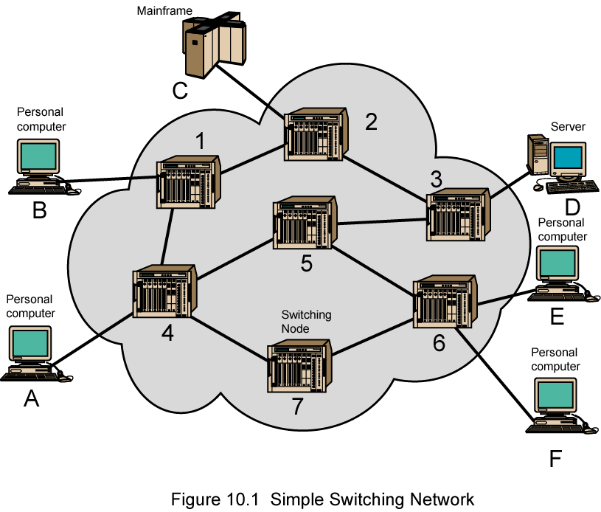
Simple Switched Network

Slide 5
Circuit Switching
Dedicated communication path between two stations
Three phases
  Establish
  Transfer
  Disconnect
Must have switching capacity and channel capacity to establish connection
Must have intelligence to work out routing

Slide 6
Circuit Switching - Applications
Inefficient
  Channel capacity dedicated for duration of connection
  If no data, capacity wasted
Set up (connection) takes time
Once connected, transfer is transparent
Developed for voice traffic (phone)

Slide 7
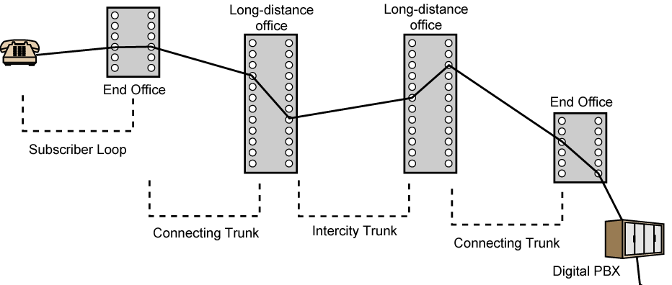
Public Circuit Switched Network

Slide 8
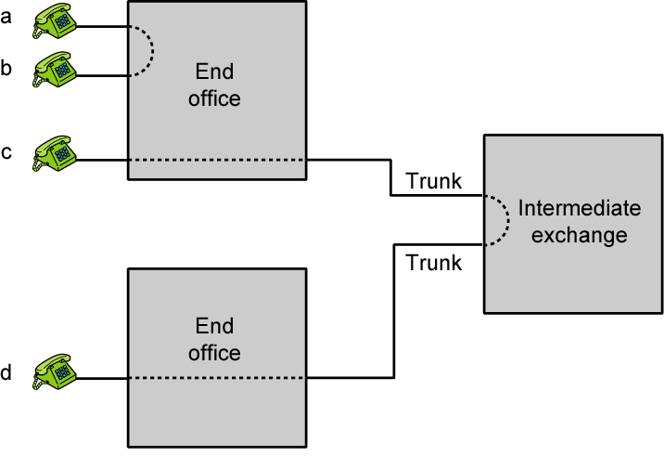
Circuit Establishment

Slide 9
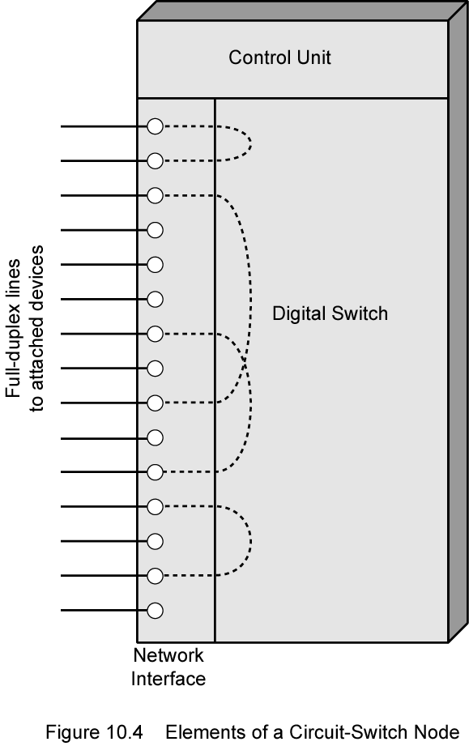
Circuit Switch Elements

Slide 10
Circuit Switching Concepts
Digital Switch
  Provide transparent signal path between devices
Network Interface
Control Unit
  Establish connections
    Generally on demand
    Handle and acknowledge requests
    Determine if destination is free
    construct path
  Maintain connection
  Disconnect

Slide 11
Blocking or Non-blocking
Blocking
  A network is unable to connect stations because all paths are in use
  A blocking network allows this
  Used on voice systems
    Short duration calls
Non-blocking
  Permits all stations to connect (in pairs) at once
  Used for some data connections

Slide 12
Space Division Switching
Developed for analog environment
Separate physical paths
Crossbar switch
  Number of crosspoints grows as square of number of stations
  Loss of crosspoint prevents connection
  Inefficient use of crosspoints
    All stations connected, only a few crosspoints in use
  Non-blocking

Slide 13
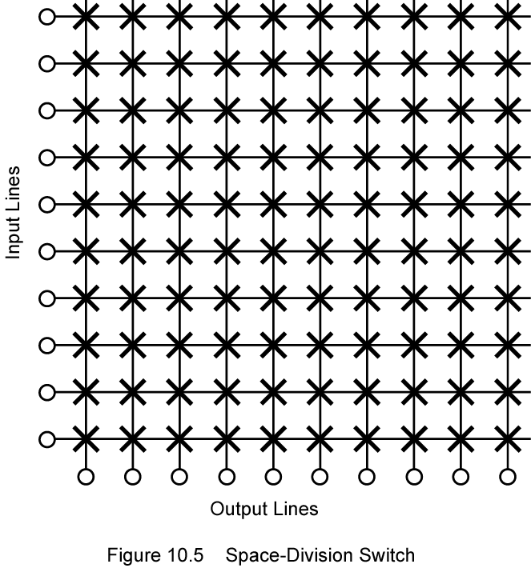
Space Division Switch

Slide 14
Multistage Switch
Reduced number of crosspoints
More than one path through network
  Increased reliability
More complex control
May be blocking

Slide 15
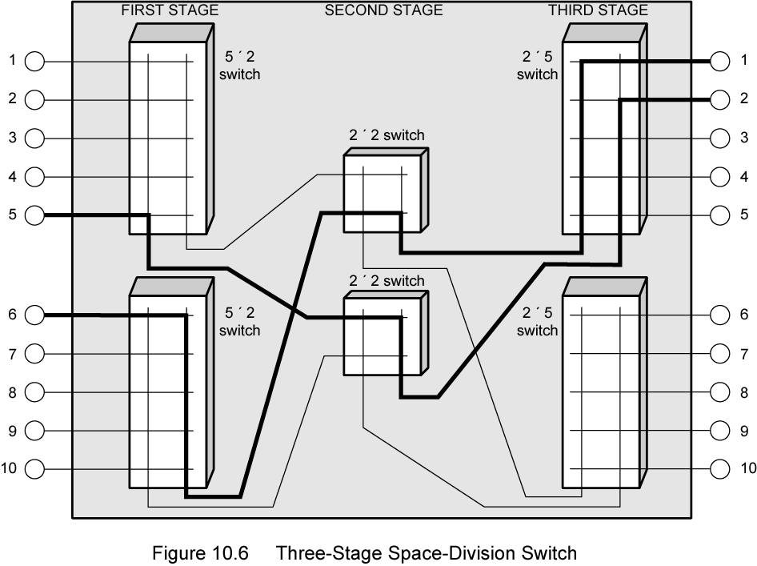
Three Stage Space Division Switch

Slide 16
Time Division Switching
Modern digital systems rely on intelligent control of space and time division elements
Use digital time division techniques to set up and maintain virtual circuits
Partition low speed bit stream into pieces that share higher speed stream

Slide 17
Control Signal Sequence
Both phones on hook
Subscriber lifts receiver (off hook)
End office switch signaled
Switch responds with dial tone
Caller dials number
If target not busy, send ringer signal to target subscriber
Feedback to caller
  Ringing tone, engaged tone, unobtainable
Target accepts call by lifting receiver
Switch terminates ringing signal and ringing tone
Switch establishes connection
Connection release when Source subscriber hangs up

Slide 18
Switch to Switch Signaling
Subscribers connected to different switches
Originating switch seizes interswitch trunk
Send off hook signal on trunk, requesting digit register at target switch (for address)
Terminating switch sends off hook followed by on hook (wink) to show register ready
Originating switch sends address

Slide 19
Softswitch Architecture
General purpose computer running software to make it a smart phone switch
Lower costs
Greater functionality
  Packetizing of digitized voice data
  Allowing voice over IP
Most complex part of telephone network switch is software controlling call process
  Call routing
  Call processing logic
  Typically running on proprietary processor
Separate call processing from hardware function of switch
Physical switching done by media gateway
Call processing done by media gateway controller

Slide 20
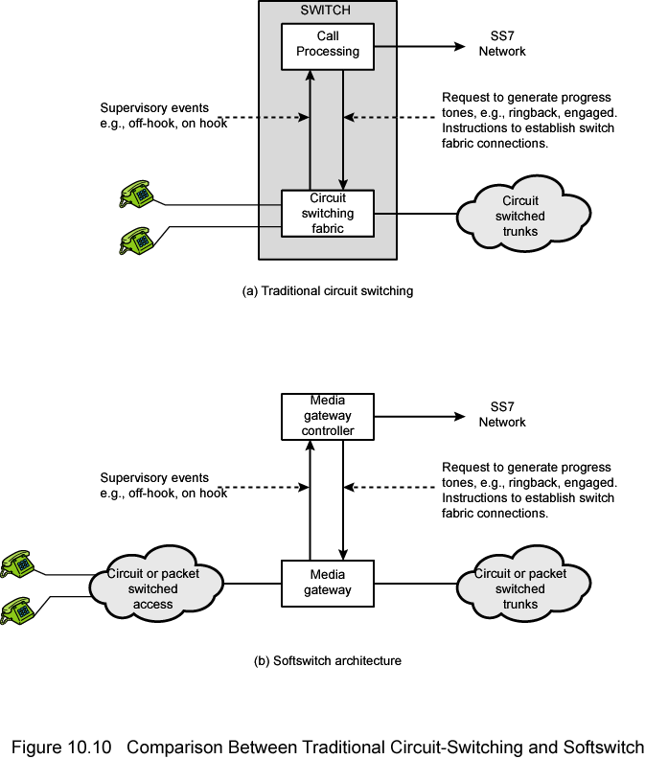
Traditional Circuit Switching

Slide 21
Softswitch

Slide 22
Packet Switching Principles
Circuit switching designed for voice
  Resources dedicated to a particular call
  Much of the time a data connection is idle
  Data rate is fixed
    Both ends must operate at the same rate

Slide 23
Basic Operation
Data transmitted in small packets
  Typically 1000 octets
  Longer messages split into series of packets
  Each packet contains a portion of user data plus some control info
Control info
  Routing (addressing) info
Packets are received, stored briefly (buffered) and past on to the next node
  Store and forward

Slide 24
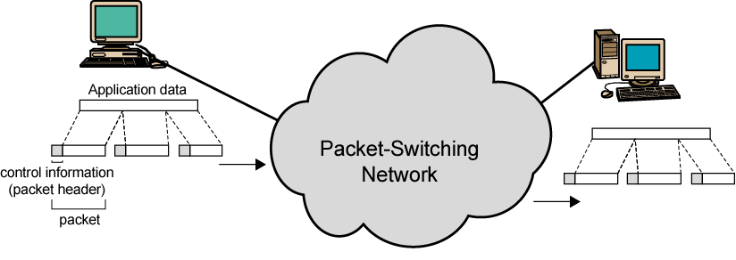
Use of Packets

Slide 25
Advantages
Line efficiency
  Single node to node link can be shared by many packets over time
  Packets queued and transmitted as fast as possible
Data rate conversion
  Each station connects to the local node at its own speed
  Nodes buffer data if required to equalize rates
Packets are accepted even when network is busy
  Delivery may slow down
Priorities can be used

Slide 26
Switching Technique
Station breaks long message into packets
Packets sent one at a time to the network
Packets handled in two ways
  Datagram
  Virtual circuit

Slide 27
Datagram
Each packet treated independently
Packets can take any practical route
Packets may arrive out of order
Packets may go missing
Up to receiver to re-order packets and recover from missing packets

Slide 28
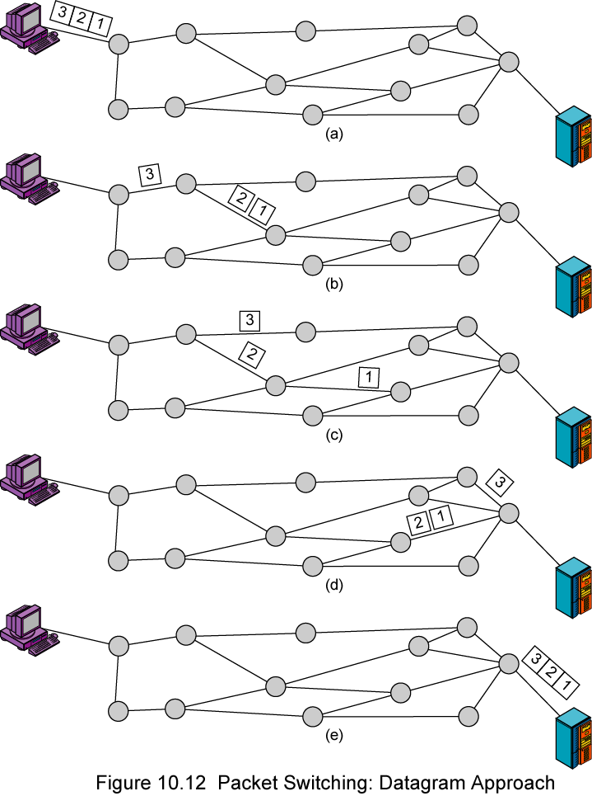
Datagram
Diagram

Slide 29
Virtual Circuit
Preplanned route established before any packets sent
Call request and call accept packets establish connection (handshake)
Each packet contains a virtual circuit identifier instead of destination address
No routing decisions required for each packet
Clear request to drop circuit
Not a dedicated path

Slide 30
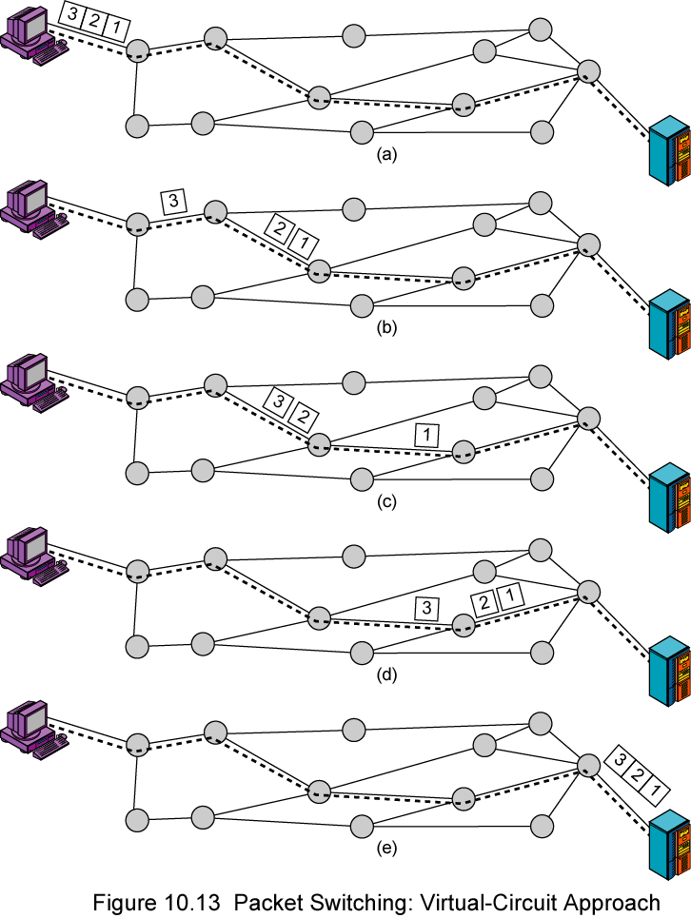
Virtual
Circuit
Diagram

Slide 31
Virtual Circuits v Datagram
Virtual circuits
  Network can provide sequencing and error control
  Packets are forwarded more quickly
    No routing decisions to make
  Less reliable
    Loss of a node looses all circuits through that node
Datagram
  No call setup phase
    Better if few packets
  More flexible
    Routing can be used to avoid congested parts of the network

Slide 32
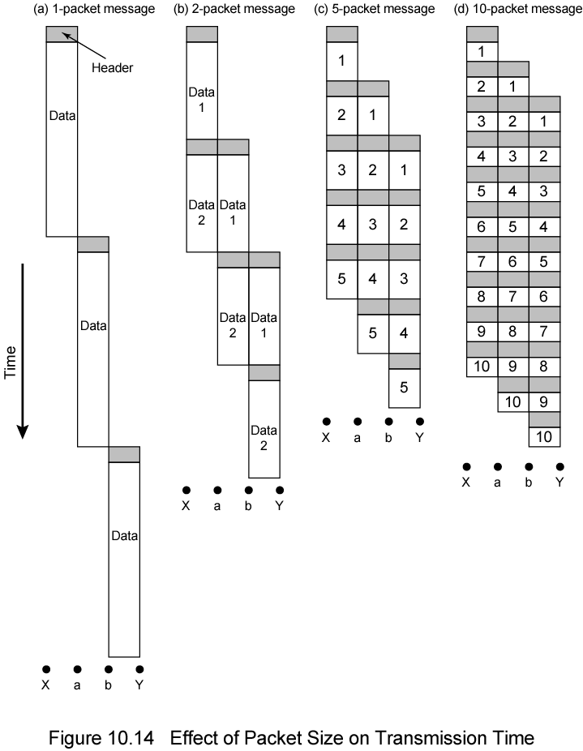
Packet Size

Slide 33
Circuit v Packet Switching
Performance
  Propagation delay
  Transmission time
  Node delay

Slide 34
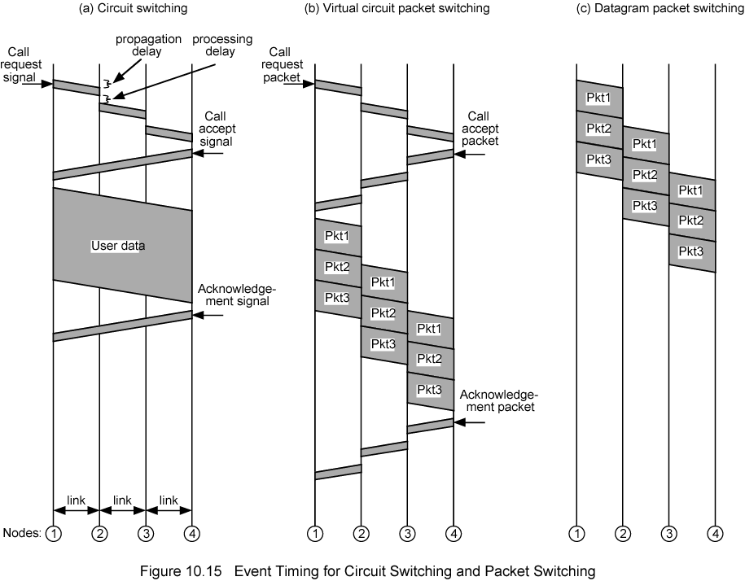
Event Timing

Slide 35
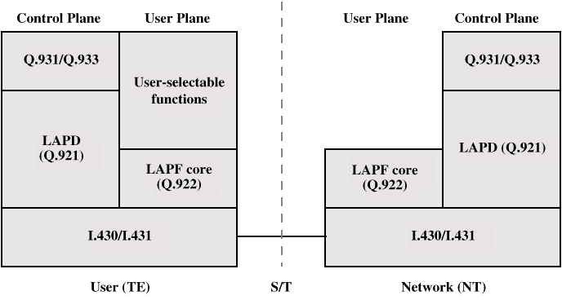
Protocol Architecture

Slide 36
Control Plane
Between subscriber and network
Separate logical channel used
  Similar to common channel signaling for circuit switching services
Data link layer
  LAPD (Q.921)
  Reliable data link control
  Error and flow control
  Between user (TE) and network (NT)
  Used for exchange of Q.933 control signal messages

Slide 37
User Plane
End to end functionality
Transfer of info between ends
LAPF (Link Access Procedure for Frame Mode Bearer Services) Q.922
  Frame delimiting, alignment and transparency
  Frame mux and demux using addressing field
  Ensure frame is integral number of octets (zero bit insertion/extraction)
  Ensure frame is neither too long nor short
  Detection of transmission errors
  Congestion control functions

Slide 38
User Data Transfer
One frame type
  User data
  No control frame
No inband signaling
No sequence numbers
  No flow nor error control

Slide 39
Thank You

